Slide 1
ALS Research Stimuli

Slide 2
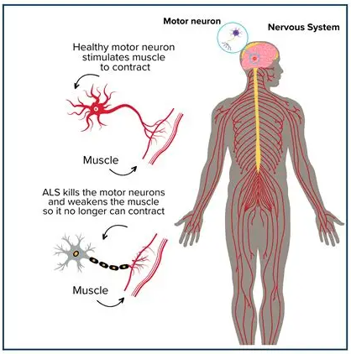
Amyotrophic lateral sclerosis: Disease Overview
Amyotrophic lateral sclerosis (ALS), formerly known as Lou Gehrig's disease, is a neurodegenerative disease that targets the nerve cells (neurons) in your brain and spinal cord.
Pathophysiology and Epidemiology
ALS is caused by motor neuron degeneration in the brain and spinal cord.
Only about 10% of cases are familial; 90% are sporadic.¹
There are about 34,000 prevalent cases in the USA.¹
Symptoms
Gradual loss of motor control affecting the arms, legs, face, and respiratory muscles.
Symptom onset and pattern of spread vary among patients, typically beginning in the limbs or bulbar region.
Symptoms worsen over time, resulting in paralysis while cognitive functions usually remain intact.
Prognosis
Symptoms usually first develop between ages of 55 - 75²
Average survival time following diagnosis is 3 years³:
20% of patients survive 5 years³
10% survive 10 years³
5% survive ≥ 20 years ³
Sources: 1. National ALS Registry Dashboard; 2. Amyotrophic Lateral Sclerosis (ALS) 3. Stages of ALS 4. Amyotrophic Lateral Sclerosis (ALS): What It Is & Symptoms 5. Picture from Understanding ALS: Symptoms, Causes, and Support | ALS United Greater NY

Slide 3




Amyotrophic lateral sclerosis: Progression Overview
ALS presents with diverse early symptoms, and while patterns of spread and progression rates vary, progressive muscle weakness and paralysis are universal outcomes.
Progression of ALS
~10-14 months
Disease Onset
Symptom Onset
Clinical Diagnosis
Treatments Start
Localized onset
Regional spread
Systemic paralysis
Changes in motor control of arms and hands Muscle twitches and cramps in the arm, leg, shoulder, or tongue Tight and stiff muscles (spasticity) Muscle weakness affecting an arm, a leg, or the neck Slurred and nasal speech Difficulty chewing or swallowing Fatigue
Dysphagia (difficulty chewing and swallowing) Sialorrhea (excessive drooling) Dysarthria (speaking or forming words) Dyspnea (shortness of breath) Pseudobulbar affect (unintended crying, laughing, or other emotional displays) Constipation Malnutrition or weight loss
Inability to stand or walk Inability to get in or out of bed independently Loss of hand and arm function Inability to breathe independently
Early-Stage ALS | Mid-Stage ALS | Late-Stage ALS
ALSFRS-R >30 | ALSFRS-R 20–30 | ALSFRS-R <20
SVC ≥70% | SVC 50–70% | SVC <50%
ALSFRS-R
Symptom Severity

Slide 4
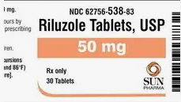

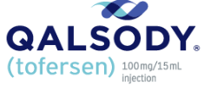
Amyotrophic lateral sclerosis: Treatment Overview
There’s no known treatment that stops or reverses the progression of ALS, even though the FDA has approved several drugs for ALS that may prolong survival, reduce the rate of decline, or help manage symptoms.
Progression of ALS
Disease Onset
Symptom Onset
~18 to 24 months
Treatments Start
Early-Stage ALS | Mid-Stage ALS | Late-Stage ALS
ALSFRS-R >30 | ALSFRS-R 20–30 | ALSFRS-R <20
SVC ≥70% | SVC 50–70% | SVC <50%
Localized onset
Regional spread
Systemic paralysis
ALS disease-modifying drugs：
Riluzole* (Rilutek®, Exservan® and Tiglutik®) may reduce damage to motor neurons. It may extend survival by a few months.
Edaravone (Radicava® and Radicava ORS®) can slow the decline in muscle functioning.
Tofersen (Qalsody®) can decrease some damage to neurons. This may help if provider finds a genetic change on the SOD1 gene.
Medication
Physical and Occupational Therapy
Nutritional Support: dietitian involvement, feeding support
Speech and Communication Support: speech therapy, assistive communication devices
Rehabilitative therapy
Airway clearance: mechanical cough assist, suction devices.
Monitoring: regular FVC/SNIP assessment and early NIV initiation.
Ventilatory support: noninvasive ventilation (NIV), mechanical ventilation as disease progresses.
Breathing support
* Generic drugs are available

Slide 5
Product X Analogues
Placeholder for Analog
These are drugs that could be considered potential analogues for Product X in ALS due to various attributes (disease prevalence, market access, dosing).
Attribute
Indication
Disease Prevalence in the US
Notes:
Annual WAC from NAVLIN (estimate)
Amvuttra: ~$477K
Adstiladrin: ~$240K
Gattex: ~$450K

Slide 6
In the right-hand column, please rate the performance of Product X on a scale from 1 to 5, where 1 is negative performance, and 5 is very positive performance.
Attributes | Assessment of Product X Performance (1-5 rating)
Efficacy
Safety
Trial Design
Ability to Fill an Unmet Need
Mechanism of Action
Dosage and Administration

Slide 7
At what net price would you consider Product X to be acceptable, expensive, and prohibitively expensive:
What net price would be | Net price per patient (per year treatment course)
Acceptable: Product X’s price is in-line with its value and there would be minimal utilization management restrictions (i.e., simple PA)
Expensive: Management restrictions on Product X would increase significantly based on price
Prohibitively Expensive: Product X will not be covered

Slide 8
Product X Pricing
Net Price Per Year | Coverage and Utilization Management | Re-authorization process
$150K
$200K
$250K
$300K
$400K
$500K

Slide 9
Amyotrophic lateral sclerosis: Key Functional Scales in Assessment
The revised amyotrophic lateral sclerosis functional rating scale (ALSFRS-R) consists of 12 criteria, is used to determine disease effects on each of these functions.
ALSFRS-R
Purpose | Primary tool to evaluate daily functional abilities in ALS
Domains (12 items) | Bulbar, Fine motor, Gross motor, Respiratory
Scoring | Each item 0–4, total 0–48 Higher = better function; Lower = greater disability
Administration | Clinician-administered interview (in-person/phone) Self-report feasible for remote follow-up
Clinical Meaning of ALSFRS-R Decline | Standardized endpoint in most ALS clinical trials Score naturally decreases as ALS progresses Mean decline ≈ 1 point/month → surrogate for disease progression* Strongly correlates with survival and meaning of ALSFRS-R Decline A 4-point decline over ~4 months may mean loss of independent walking or feeding Slower decline = preserved independence and reduced caregiver burden
ALSFRS-R
Symptom Severity
Early-Stage ALS | Mid-Stage ALS | Late-Stage ALS
ALSFRS-R >30 | ALSFRS-R 20–30 | ALSFRS-R <20
SVC ≥70% | SVC 50–70% | SVC <50%
Definitions: QoL = quality of life. * Many studies mentioned it, see e.g., Iazzolino et al. “Clinical Determinants of Disease Progression in ALS” (2021) — mean early slope ~1 point/month.

Slide 10
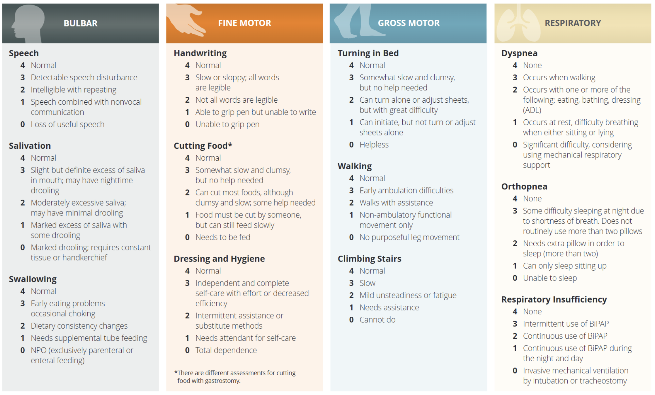
Amyotrophic lateral sclerosis: Key Functional Scales in Assessment
The revised amyotrophic lateral sclerosis functional rating scale (ALSFRS-R) consists of 12 criteria, is used to determine disease effects on each of these functions.
Source: ALS Functional Rating Scale Revised Guide

Slide 11
Product X: Target Product Profile (Base case)
ILLUSTRATIVE
 | Product X | Edaravone
 |  | Radicava ORS®¹
DESCRIPTION |  | RADICAVA ORS® (edaravone) is an oral suspension formulation of RADICAVA
INDICATION |  | The treatment of amyotrophic lateral sclerosis (ALS).
TRIAL DESIGN/ POPULATION |  | RCT: 6-month, placebo & controlled, double-blind study ALS Population: 137 Japanese patients living independently with early-stage disease (ALSFRS-R ≥ 2 pts/item, %FVC ≥ 80%, disease ≤ 2 yrs).
EFFICACY |  | ALSFRS-R total scores change from baseline to Week 24: Placebo arm: -5.01 RADICAVA arm: -7.50 (p = 0.0013)
SAFETY AND TOLERABILITY |  | Across multiple studies, RADICAVA and placebo showed similar adverse events
DOSING AND ADMINISTRATION |  | Taken once per day in morning orally or via feeding tube Drug is taken in cycles of 14 days on (10-14 doses per cycle) + 14 days off
MOA |  | The mechanism by which edaravone exerts its therapeutic effect in patients with ALS is unknown. Its mechanism may be neuroprotective by reducing oxidative stress on neurons.
Definitions: ALSFRS-R = ALS Functional Rating Scale–Revised score, %FVC = percent-predicted forced vital capacity
Sources: 1. RADICAVA ORS Prescribing Information. 2. Cruz MP. Edaravone (Radicava): A Novel Neuroprotective Agent for the Treatment of Amyotrophic Lateral Sclerosis. P T. 2018;43(1):25-28.

Slide 12
Product X: Target Product Profile (Upside case)
ILLUSTRATIVE
 | Product X | Edaravone
 |  | Radicava ORS®¹
DESCRIPTION |  | RADICAVA ORS® (edaravone) is an oral suspension formulation of RADICAVA
INDICATION |  | The treatment of amyotrophic lateral sclerosis (ALS).
TRIAL DESIGN/ POPULATION |  | RCT: 6-month, placebo & controlled, double-blind study ALS Population: 137 Japanese patients living independently with early-stage disease (ALSFRS-R ≥ 2 pts/item, %FVC ≥ 80%, disease ≤ 2 yrs).
EFFICACY |  | ALSFRS-R total scores change from baseline to Week 24: Placebo arm: -5.01 RADICAVA arm: -7.50 (p = 0.0013)
SAFETY AND TOLERABILITY |  | Across multiple studies, RADICAVA and placebo showed similar adverse events
DOSING AND ADMINISTRATION |  | Taken once per day in morning orally or via feeding tube Drug is taken in cycles of 14 days on (10-14 doses per cycle) + 14 days off
MOA |  | The mechanism by which edaravone exerts its therapeutic effect in patients with ALS is unknown. Its mechanism may be neuroprotective by reducing oxidative stress on neurons.
Definitions: ALSFRS-R = ALS Functional Rating Scale–Revised score, %FVC = percent-predicted forced vital capacity
Sources: 1. RADICAVA ORS Prescribing Information. 2. Cruz MP. Edaravone (Radicava): A Novel Neuroprotective Agent for the Treatment of Amyotrophic Lateral Sclerosis. P T. 2018;43(1):25-28.

Slide 13
Product X: Target Product Profile (Fallback case)
ILLUSTRATIVE
 | Product X | Edaravone
 |  | Radicava ORS®¹
DESCRIPTION |  | RADICAVA ORS® (edaravone) is an oral suspension formulation of RADICAVA
INDICATION |  | The treatment of amyotrophic lateral sclerosis (ALS).
TRIAL DESIGN/ POPULATION |  | RCT: 6-month, placebo & controlled, double-blind study ALS Population: 137 Japanese patients living independently with early-stage disease (ALSFRS-R ≥ 2 pts/item, %FVC ≥ 80%, disease ≤ 2 yrs).
EFFICACY |  | ALSFRS-R total scores change from baseline to Week 24: Placebo arm: -5.01 RADICAVA arm: -7.50 (p = 0.0013)
SAFETY AND TOLERABILITY |  | Across multiple studies, RADICAVA and placebo showed similar adverse events
DOSING AND ADMINISTRATION |  | Taken once per day in morning orally or via feeding tube Drug is taken in cycles of 14 days on (10-14 doses per cycle) + 14 days off
MOA |  | The mechanism by which edaravone exerts its therapeutic effect in patients with ALS is unknown. Its mechanism may be neuroprotective by reducing oxidative stress on neurons.
Definitions: ALSFRS-R = ALS Functional Rating Scale–Revised score, %FVC = percent-predicted forced vital capacity
Sources: 1. RADICAVA ORS Prescribing Information. 2. Cruz MP. Edaravone (Radicava): A Novel Neuroprotective Agent for the Treatment of Amyotrophic Lateral Sclerosis. P T. 2018;43(1):25-28.

Slide 14
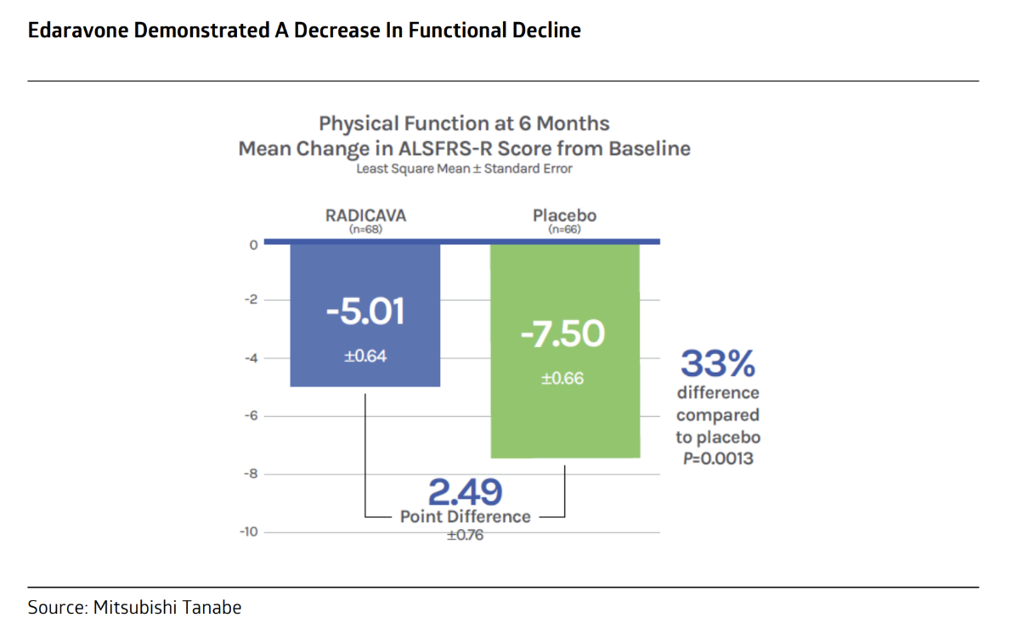
Benchmarking Clinical Endpoints in Approved ALS Therapies
Approved ALS therapies demonstrate varied clinical endpoints — from survival extension to functional preservation — providing key references for NUZ-001’s endpoint strategy.
 | Riluzole (Rilutek®, Exservan® and Tiglutik®) |  |  | Edaravone |  |  | Tofersen (Qalsody®) ³
 | RILUTEK®⁴ | Exservan®⁶ | Tiglutik®⁵ | Radicava®¹ |  | Radicava ORS®²
Clinical Study Design | 2 randomized, double-blind, placebo-controlled trials 155 (France/Belgium) + 959 (EU/NA) ALS patients (disease ≤ 5 yrs), ≥12 months follow-up |  |  | 6-month, randomized, placebo controlled 68 ALS patients (Japan) with early-stage disease (ALSFRS-R ≥ 2 pts/item, %FVC ≥ 80%, disease ≤ 2 yrs) |  |  | • 28-week, randomized, placebo-controlled trial • 108 ALS patients, SOD1 mutation, aged 23–78 yrs
Endpoint | Primary: time to tracheostomy or death Study 1: median survival increased by ~90 days Study 2: median survival increased by ~ 60 days |  |  | Primary: ALSFRS-R total scores change (Week 24) Treatment Difference (RADICAVA – placebo [95% CI]) is 2.49 (0.99, 3.98) , p = 0.0013 |  |  | Primary: ALSFRS-R total scores change (Week 28) Treatment not statistically significant Secondary: plasma NfL and CSF SOD1 protein change (Week 28) Treatment Difference (QALSODY – placebo [95% CI]) is 0.40 (0.33, 0.49) and 0.33 (0.25, 0.45), p value <0.0001 for both outcomes
Admin | 50 mg every 12 hours | 50 mg 2.day | 50 mg (10 mL), 2/day, orally or via PEG-tubes | Intravenous infusion * 14 days, followed by a 14-day rest Then 10 days on /14-day periods, followed by 14-day off (Cycles 2-6). |  |  | 100 mg IT (15 mL) per dose 3 loading doses, then q28 days maintenance
WAC Price Per Year |  |  |  | Year 1: $153,830 | Year 2: $149,272 | Year 1: $170,561 | Year 2: $165,508
US Sales⁷ | NA | NA | NA | ~ $576 M Radicava® |  |  | ~ $21 M
Currently available ALS Medications
Definitions: ALSFRS-R = ALS Functional Rating Scale–Revised score, SVC = slow vital capacity, %FVC = percent-predicted forced vital capacity, PEG-tubes = endoscopic gastrostomy tubes
Sources: 1. RADICAVA Prescribing Information 2. RADICAVA ORS Prescribing Information. 3. Tofersen Prescribing Information 4. RILUTEK Prescribing Information. 5. TIGLUTIK Prescribing Information 6. EXSERVAN Prescribing Information 7. Evaluate Pharma

Slide 15
Unused slides

Slide 16
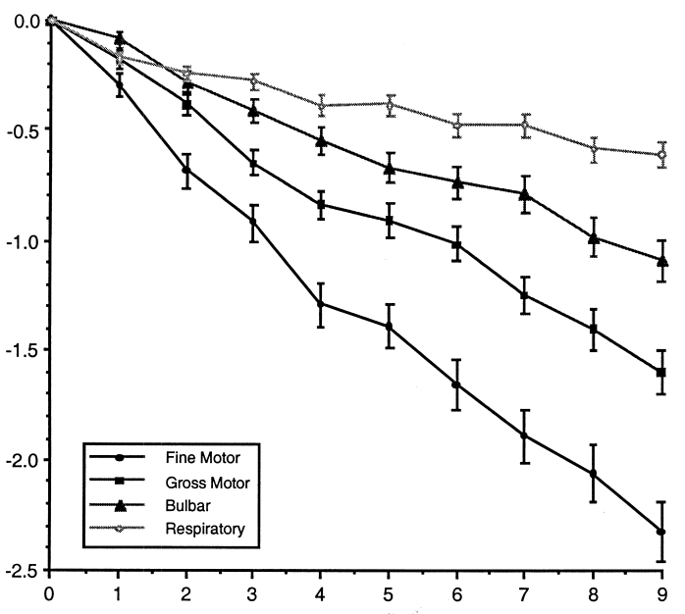
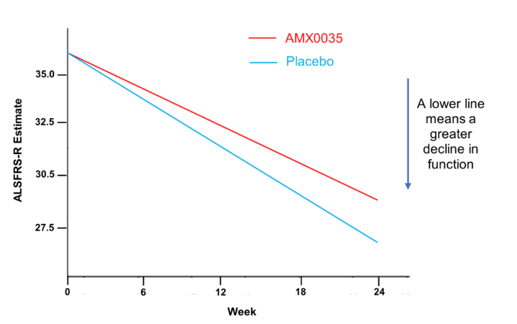
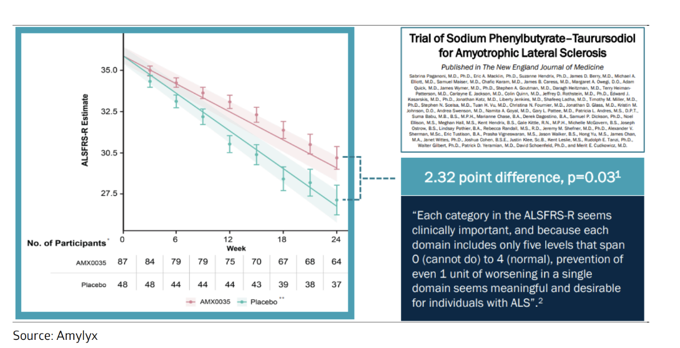
Amyotrophic lateral sclerosis: Key Functional Scales in Assessment
The revised amyotrophic lateral sclerosis functional rating scale (ALSFRS-R) consists of 12 criteria, is used to determine disease effects on each of these functions.
ALSFRS-R
Purpose | Primary tool to evaluate daily functional abilities in ALS
Domains (12 items) | Bulbar, Fine motor, Gross motor, Respiratory
Scoring | Each item 0–4, total 0–48 Higher = better function; Lower = greater disability
Administration | Clinician-administered interview (in-person/phone) Self-report feasible for remote follow-up.
Clinical Meaning of ALSFRS-R Decline | Standardized endpoint in most ALS clinical trials Score naturally decreases as ALS progresses Mean decline ≈ 1 point/month → surrogate for disease progression Strongly correlates with survival and Meaning of ALSFRS-R Decline A 4-point decline over ~4 months may mean loss of independent walking or feeding Slower decline = preserved independence and reduced caregiver burden
Cross-sectional mean change from baseline to 9 months for each of the four factors of the ALSFRS-R²
ILLUSTRATIVE
Change from Baseline
Intervention
Δ_{I}
Δ_{P}
Month
With ALS disease progression, the ALSFRS-R score will decrease
Most of ALS treatment clinical studies will define the ALSFRS-R score change from baseline to week N (Δ_{I}
vs. Δ_{P}) the as primary endpoint
Definitions: QoL = quality of life. Sources: 1. Gül Koç, Gizem et al. “Evaluation of ALSFRS-R Scale with Fuzzy Method in Amyotrophic Lateral Sclerosis.” Noro psikiyatri arsivi vol. 59,1 54-62. 31 Jan. 2022, doi:10.29399/npa.27449. 2. The ALSFRS-R: a revised ALS functional rating scale that incorporates assessments of respiratory function. Cedarbaum, Jesse M. et al.. Journal of the Neurological Sciences, Volume 169, Issue 1, 13 - 21

Slide 17
Amyotrophic Lateral Sclerosis (ALS) Disease Symptoms
Muscle twitches in the arm, leg, shoulder, or tongue Muscle cramps Tight and stiff muscles (spasticity) Muscle weakness affecting an arm, a leg, or the neck Slurred and nasal speech Difficulty chewing or swallowing Chewing food and swallowing (dysphagia) Drooling (sialorrhea) Speaking or forming words (dysarthria) Breathing (dyspnea) Unintended crying, laughing, or other emotional displays (pseudobulbar symptoms) Constipation Maintaining a healthy weight and getting enough nutrients Unable to stand or walk, get in or out of bed on their own, use their hands and arms, or breathe on their own
Early symptoms
FDA Approved drugs
Riluzole
Edaravone
Tofersen
Disorder progression
symptoms
Late Stage

Slide 18

Amyotrophic lateral sclerosis Disease Overview
Draft
Amyotrophic lateral sclerosis (ALS), formerly known as Lou Gehrig's disease, is a neurodegenerative disease that targets the nerve cells (neurons) in your brain and spinal cord.
It affects patient’s muscle control. Symptoms worsen over time.
ALS
US ALS Prevalence¹
Symptoms most commonly develop ages of 55 - 75²
Average survival time is 3 years, ~ 20% lives 5 years, 10% lives 10 years and 5% lives ≥ 20 years ³
Mutations (changes) in more than a dozen genes have been found to cause familial ALS²
25% - 40% C9orf72 gene
12% - 20% SOD1 gene
~1.1 in 10,000 the US¹
ALS Diagnosis is complex, delayed, and often requiring multidisciplinary expertise, which may include⁴:
Blood tests
Urine tests
Electromyogram (EMG) to test muscle activity
Nerve conduction study to test nerves’ ability to send signals
Magnetic resonance imaging (MRI)
Familial
Sporadic
~34,000
cases in the US²
Sources: 1. National ALS Registry Dashboard; 2. Amyotrophic Lateral Sclerosis (ALS) 3. Stages of ALS 4. Amyotrophic Lateral Sclerosis (ALS): What It Is & Symptoms

Slide 19
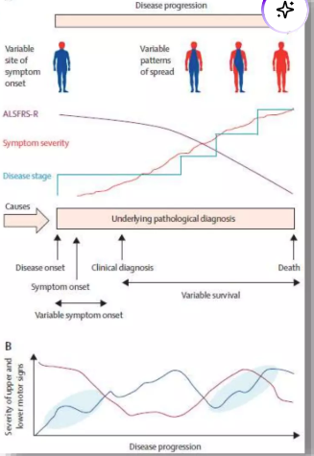
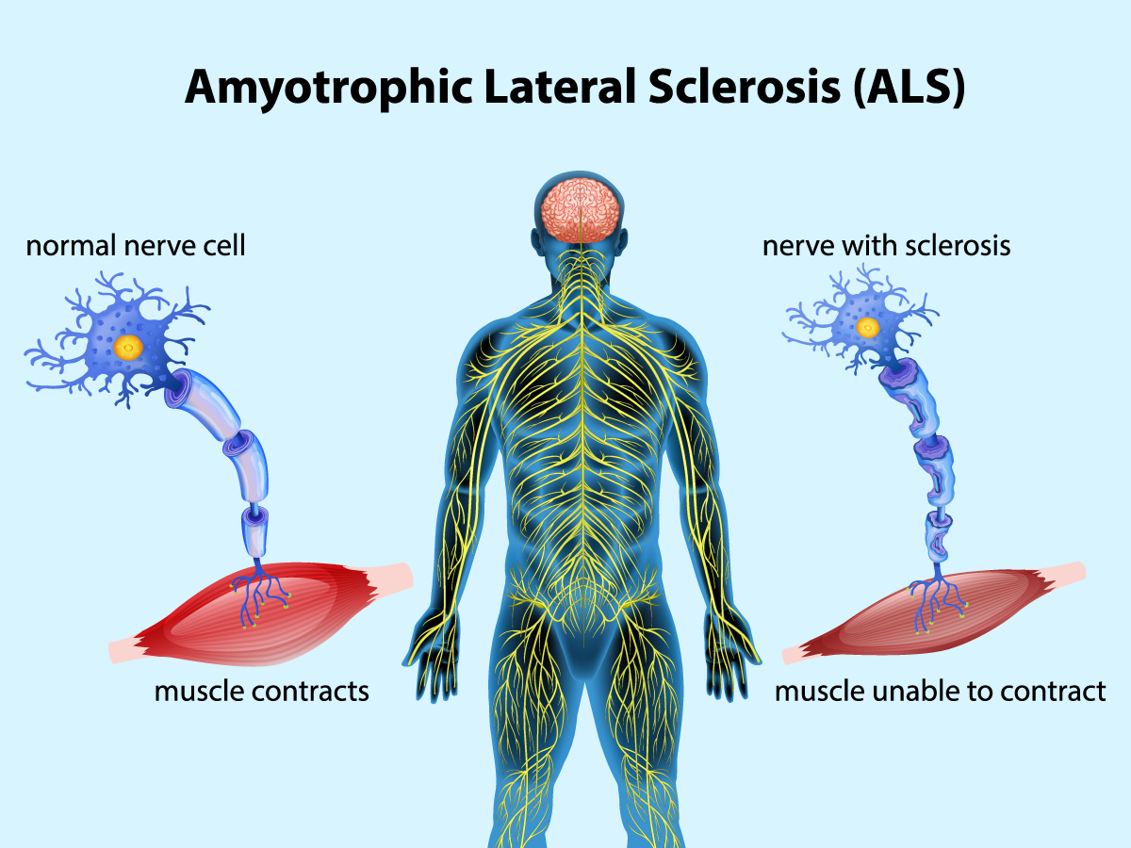

Slide 20
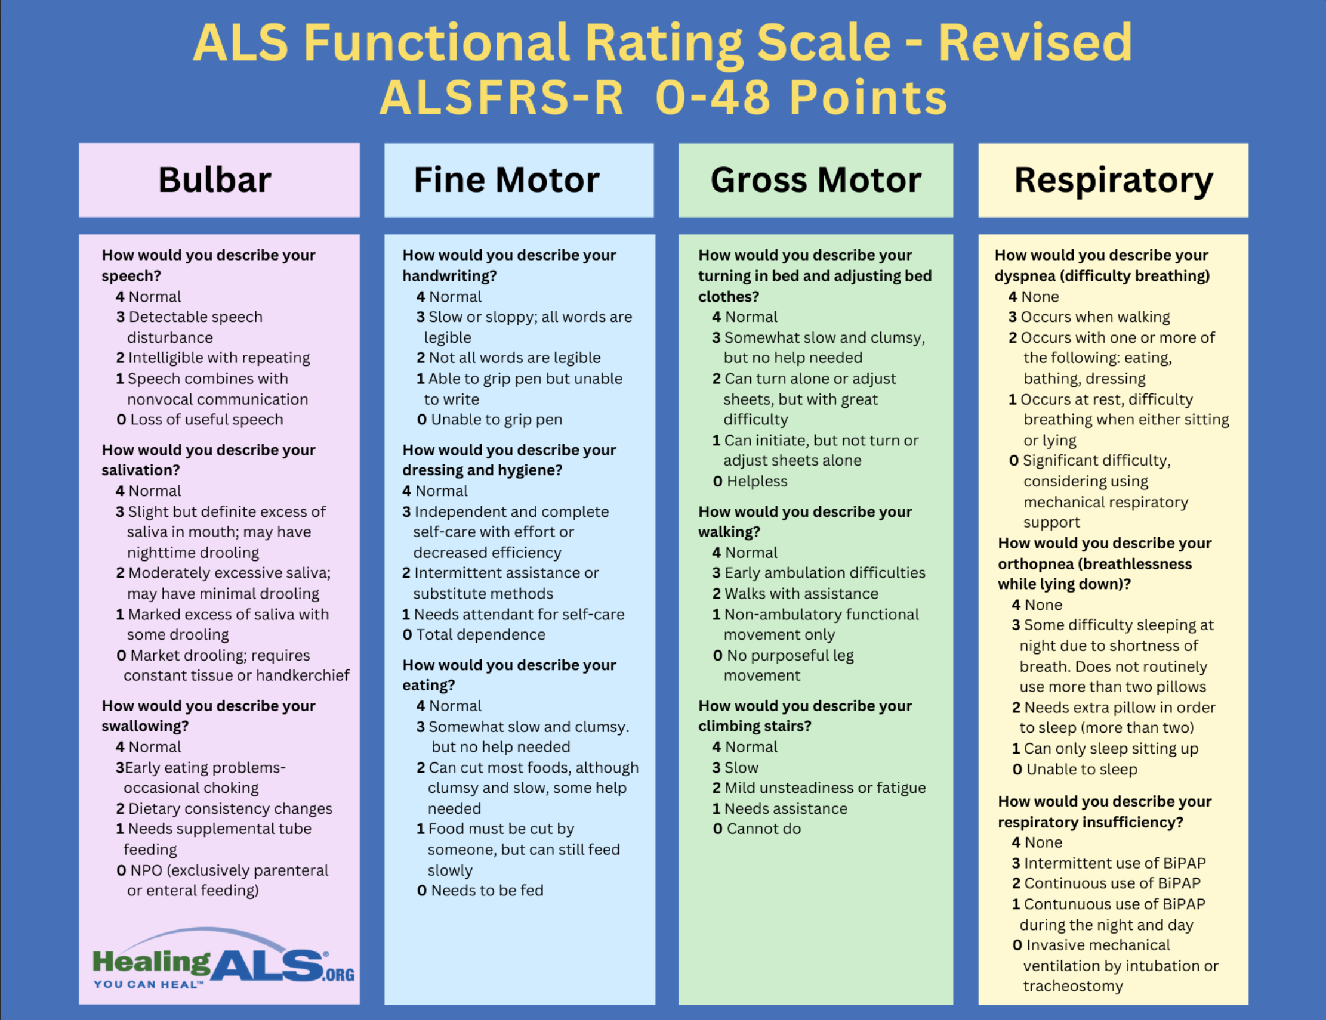
ALSFRS-R
Symptom Severity
Early-Stage ALS | Mid-Stage ALS | Late-Stage ALS
ALSFRS-R >30 | ALSFRS-R 20–30 | ALSFRS-R <20
SVC ≥70% | SVC 50–70% | SVC <50%

Slide 21
BULBAR
FINE MOTOR
GROSS MOTOR
RESPIRATORY
Speech
4 Normal
3 Detectable speech disturbance
2 Intelligible with repeating
1 Speech combined with nonvocal communication
0 Loss of useful speech
Salivation
4 Normal
3 Slight but definite excess of saliva in mouth; may have nighttime drooling
2 Moderately excessive saliva; may have minimal drooling
1 Marked excess of saliva with some drooling
0 Marked drooling; requires constant tissue or handkerchief
Swallowing
4 Normal
3 Early eating problems — occasional choking
2 Dietary consistency changes
1 Needs supplemental tube feeding
0 NPO (exclusively parenteral or enteral feeding)
Handwriting
4 Normal
3 Slow or sloppy; all words are legible
2 Not all words are legible
1 Able to grip pen but unable to write
0 Unable to grip pen
Cutting Food *
4 Normal
3 Somewhat slow and clumsy, but no help needed
2 Can cut most foods, although clumsy and slow; some help needed
1 Food must be cut by someone, but can still feed slowly
0 Needs to be fed
Dressing and Hygiene
4 Normal
3 Independent and complete self-care with effort or decreased efficiency
2 Intermittent assistance or substitute methods
1 Needs attendant for self-care
0 Total dependence
* There are different assessments for cutting food with gastrostomy.
Turning in Bed
4 Normal
3 Somewhat slow and clumsy, but no help needed
2 Can turn alone or adjust sheets, but with great difficulty
1 Can initiate, but not turn or adjust sheets alone
0 Helpless
Walking
4 Normal
3 Early ambulation difficulties
2 Walks with assistance
1 Non-ambulatory functional movement only
0 No purposeful leg movement
Climbing Stairs
4 Normal
3 Slow
2 Mild unsteadiness or fatigue
1 Needs assistance
0 Cannot do
Dyspnea
4 None
3 Occurs when walking
2 Occurs with one or more of the following: eating, bathing, dressing (ADL)
1 Occurs at rest, difficulty breathing when either sitting or lying0 Significant difficulty, considering using mechanical respiratory support
Orthopnea
4 None
3 Some difficulty sleeping at night due to shortness of breath. Does not routinely use more than two pillows
2 Needs extra pillow in order to sleep (more than two)
1 Can only sleep sitting up
0 Unable to sleep
Respiratory Insufficiency
4 None
3 Intermittent use of BiPAP
2 Continuous use of BiPAP
1 Continuous use of BiPAP during the night and day
0 Invasive mechanical ventilation by intubation or tracheostomy

Slide 22
Amyotrophic lateral sclerosis: Progression and Treatments
Early-Stage ALS | Mid-Stage ALS | Late-Stage ALS
ALSFRS-R >30 | ALSFRS-R 20–30 | ALSFRS-R <20
SVC ≥70% | SVC 50–70% | SVC <50%
Localized onset
Regional spread
Systemic paralysis
Limb onset
Respiratory failure
Inability to eat
Bulbar onset
Respiratory onset
Medication
Rehabilitative therapy
Breathing support

Slide 23
Amyotrophic lateral sclerosis: Progression and Treatments
Early-Stage ALS | Mid-Stage ALS | Late-Stage ALS
ALSFRS-R >30 | ALSFRS-R 20–30 | ALSFRS-R <20
SVC ≥70% | SVC 50–70% | SVC <50%
Medication
Rehabilitative therapy
Breathing support
Riluzole (Rilutek®, Exservan® and Tiglutik®) may reduce damage to motor neurons. It may extend survival by a few months.
Edaravone (Radicava® and Radicava ORS®) can slow the decline in muscle functioning.
Tofersen (Qalsody®) can decrease some damage to neurons. This may help if provider finds a genetic change on the SOD1 gene.

Slide 24
Amyotrophic Lateral Sclerosis (ALS) US Treatment Guidelines
Draft
There’s no known treatment that stops or reverses the progression of ALS, even though the FDA has approved several drugs for ALS that may prolong survival, reduce the rate of decline, or help manage symptoms.
Medications
Nutritional support
(e.g., dietitian helps with meal plan that avoids hard-to-swallow foods)
Riluzole
Edaravone
Tofersen
May reduce damage to motor neurons.
It may extend survival by a few months.
Generic available
Can slow the decline in your muscle functioning.
Can decrease some damage to neurons, which may help if finds a genetic change on the SOD1 gene.
Therapies
(e.g., Physical therapy, Occupational therapy, Speech therapy )
Other medications are available to manage symptoms:
muscle cramps,
stiffness and excess saliva production,
pain
mental health challenges
Breathing support
(e.g., Noninvasive ventilation. mechanical ventilation)
Sources: 1. Amyotrophic Lateral Sclerosis (ALS): What It Is & Symptoms
There are currently no FDA-approved branded treatments for SPS; all current therapies are used off-label

Slide 25
Amyotrophic Lateral Sclerosis (ALS) US Treatment Guidelines
Draft
There’s no known treatment that stops or reverses the progression of ALS, even though the FDA has approved several drugs for ALS that may prolong survival, reduce the rate of decline, or help manage symptoms.
Medications
Nutritional support
(e.g., dietitian helps with meal plan that avoids hard-to-swallow foods)
Riluzole
Edaravone
Tofersen
May reduce damage to motor neurons.
It may extend survival by a few months.
Generic available
Can slow the decline in your muscle functioning.
Can decrease some damage to neurons, which may help if finds a genetic change on the SOD1 gene.
Therapies
(e.g., Physical therapy, Occupational therapy, Speech therapy )
Other medications are available to manage symptoms:
muscle cramps,
stiffness and excess saliva production,
pain
mental health challenges
Breathing support
(e.g., Noninvasive ventilation. mechanical ventilation)
Sources: 1. Amyotrophic Lateral Sclerosis (ALS): What It Is & Symptoms
There are currently no FDA-approved branded treatments for SPS; all current therapies are used off-label

Slide 26
Amyotrophic Lateral Sclerosis (ALS) Treatment Overview
Draft
There’s no known treatment that stops or reverses the progression of ALS, even though the FDA has approved several drugs for ALS that may prolong survival, reduce the rate of decline, or help manage symptoms.
 | Early-Stage ALS ALSFRS-R >30 / SVC ≥70% | Mid-Stage ALS ALSFRS-R 20–30 / SVC 50–70% | Late-Stage ALS ALSFRS-R <20 / SVC <50%
Limb-onset
Bulbar-onset
Respiratory-onset
Medications
Riluzole (Rilutek®, Exservan® and Tiglutik®) may reduce damage to motor neurons. It may extend survival by a few months.
Other medications are available to manage symptoms:
muscle cramps,
stiffness and excess saliva production,
pain
mental health challenges
Nutritional support
(e.g., dietitian helps with meal plan that avoids hard-to-swallow foods)
Edaravone (Radicava® and Radicava ORS®) can slow the decline in muscle functioning.
Therapies or rehabilitation
(e.g., Physical therapy, Occupational therapy, Speech therapy )
Tofersen (Qalsody®) can decrease some damage to neurons. This may help if provider finds a genetic change on the SOD1 gene.
Breathing support
(e.g., Noninvasive ventilation. mechanical ventilation)
Stage categorization shown for illustrative purposes; treatment timing is not formally stage-restricted in current ALS guidelines.
Definitions: ALSFRS-R = ALS Functional Rating Scale–Revised score, SVC = slow vital capacity. Sources: 1. National Institute of Neurological Disorders and Stroke (NINDS) 2. AAN – Practice Parameter: The Care of the Patient with ALS (Update 2020) . Note: for Edaravone While FDA labeling for edaravone does not limit use by disease stage, pivotal trial evidence and payer criteria support initiation in early, functionally preserved ALS patients (ALSFRS-R ≥30, SVC ≥70%).

Slide 27
Amyotrophic lateral sclerosis: Progression Overview
ALS presents with diverse early symptoms, and while patterns of spread and progression rates vary, progressive muscle weakness and paralysis are universal outcomes.
Progression of ALS
ALSFRS-R
Symptom Severity
Localized onset
Regional spread
Systemic paralysis
Limb onset | Muscle weakness, twitches, stiffness in limb muscles
Bulba-onset | Slurred speech, chewing/swallowing difficulties
Respiratory-onset | Shortness of breath on exertion, orthopnea
Speech or swallowing difficulties as bulbar regions become involved
Progression to limb weakness and respiratory involvement
Daytime dyspnea, fatigue
Loss of ambulation, hand function, or bed mobility
Complete loss of speech and swallowing; ventilatory dependence
Inability to breathe independently
Early-Stage ALS | Mid-Stage ALS | Late-Stage ALS
ALSFRS-R >30 | ALSFRS-R 20–30 | ALSFRS-R <20
SVC ≥70% | SVC 50–70% | SVC <50%

Slide 28
Amyotrophic lateral sclerosis: Treatment Overview
There’s no known treatment that stops or reverses the progression of ALS, even though the FDA has approved several drugs for ALS that may prolong survival, reduce the rate of decline, or help manage symptoms.
Progression of ALS
Localized onset
Regional spread
Systemic paralysis
ALS disease-modifying drugs：
Riluzole (Rilutek®, Exservan® and Tiglutik®) may reduce damage to motor neurons. It may extend survival by a few months.
Physical and Occupational Therapy
Airway clearance: mechanical cough assist, suction devices
Edaravone (Radicava® and Radicava ORS®) can slow the decline in muscle functioning.
Nutritional Support: dietitian involvement, feeding support
Monitoring: regular FVC/SNIP assessment and early NIV initiation.
Speech and Communication Support: speech therapy, assistive communication devices
Ventilatory support: noninvasive ventilation (NIV), mechanical ventilation as disease progresses
Tofersen (Qalsody®) can decrease some damage to neurons. This may help if provider finds a genetic change on the SOD1 gene.
Medication | Rehabilitative therapy | Breathing support
Total cost
Inpatient cost
Outpatient cost
ED cost
Pharmacy cost
Early-Stage ALS | Mid-Stage ALS | Late-Stage ALS
ALSFRS-R >30 | ALSFRS-R 20–30 | ALSFRS-R <20
SVC ≥70% | SVC 50–70% | SVC <50%
Annual Health Care Resource Utilization and Costs by ALS Severity Stage

Slide 29
Amyotrophic lateral sclerosis: Treatment Overview
There’s no known treatment that stops or reverses the progression of ALS, even though the FDA has approved several drugs for ALS that may prolong survival, reduce the rate of decline, or help manage symptoms.
Progression of ALS
Localized onset
Regional spread
Systemic paralysis
ALS disease-modifying drugs：
Riluzole (Rilutek®, Exservan® and Tiglutik®) may reduce damage to motor neurons. It may extend survival by a few months.
Edaravone (Radicava® and Radicava ORS®) can slow the decline in muscle functioning.
Tofersen (Qalsody®) can decrease some damage to neurons. This may help if provider finds a genetic change on the SOD1 gene.
Medication
Physical and Occupational Therapy
Nutritional Support: dietitian involvement, feeding support
Speech and Communication Support: speech therapy, assistive communication devices
Rehabilitative therapy
Airway clearance: mechanical cough assist, suction devices
Monitoring: regular FVC/SNIP assessment and early NIV initiation
Ventilatory support: noninvasive ventilation (NIV), mechanical ventilation as disease progresses
Breathing support
Annual Health Care Resource Utilization and Costs* by ALS Severity Stage
Total cost
Inpatient cost
Outpatient cost
ED cost
Pharmacy cost
Early-Stage ALS (ALSFRS-R >30, SVC ≥70%) | Mid-Stage ALS (ALSFRS-R 20–30, SVC 50–70%) | Late-Stage ALS (ALSFRS-R <20, SVC <50%)
*Per person per year. Resource: Stenson, Katie et al. “Health care resource utilization and costs across stages of amyotrophic lateral sclerosis in the United States.” Journal of managed care & specialty pharmacy vol. 30,11 (2024): 1239-1247. doi:10.18553/jmcp.2024.30.11.1239

Slide 30
Product X: Target Product Profile (Base case)
ILLUSTRATIVE
 | Product X | Edaravone
 |  | Radicava®¹ | Radicava ORS®¹
DESCRIPTION |  | RADICAVA ORS® (edaravone) is an ORAL administration option of RADICAVA® (edaravone), an ALS treatment shown to slow the loss of physical function.
INDICATION |  | The treatment of amyotrophic lateral sclerosis (ALS).
TRIAL DESIGN/ POPULATION |  | RCT: 6-month, placebo & controlled, double-blind study ALS Population: 137 Japanese patients living independently with early-stage disease (ALSFRS-R ≥ 2 pts/item, %FVC ≥ 80%, disease ≤ 2 yrs).
EFFICACY |  | Primary: RADICAVA vs. Placebo in the ALSFRS-R total scores change from baseline to Week 24. Treatment Difference: (RADICAVA – placebo [95% CI]) is 2.49 (0.99, 3.98) , p = 0.0013 .
SAFETY AND TOLERABILITY |  | RCT (n=184): ≥ 10% patients RADICAVA and greater than placebo, 60mg 6 months, most common adverse reactions are contusion, gait disturbance, and headache. | Open-label (n=185): RADICAVA ORS 6 months, fatigue was observed in 7.6% of patients.
DOSING AND ADMINISTRATION |  | Administration: intravenous infusion. Recommended dosing: 60 mg. | Administration: orally or via feeding tube. Recommended dosing: 105 mg (5 mL).
 |  | Daily 14 days, followed by a 14-day rest (Cycles 1). Then daily10 days on 14-day periods, followed by 14-day off (Cycles 2-6).
MOA |  | The mechanism by which RADICAVA and RADICAVA ORS exert their therapeutic effect in patients with ALS is unknown. Its therapeutic may be due to its known antioxidant properties; oxidative stress is a part of the process that kills neurons in patients with ALS.²
Definitions: ALSFRS-R = ALS Functional Rating Scale–Revised score, %FVC = percent-predicted forced vital capacity
Sources: 1. RADICAVA ORS Prescribing Information. 2. Cruz MP. Edaravone (Radicava): A Novel Neuroprotective Agent for the Treatment of Amyotrophic Lateral Sclerosis. P T. 2018;43(1):25-28.

Slide 31
Product X: Target Product Profile (Upside)
ILLUSTRATIVE
 | Product X | Edaravone
 |  | Radicava®¹ | Radicava ORS®¹
DESCRIPTION |  | RADICAVA ORS® (edaravone) is an ORAL administration option of RADICAVA® (edaravone), an ALS treatment shown to slow the loss of physical function.
INDICATION |  | The treatment of amyotrophic lateral sclerosis (ALS).
TRIAL DESIGN/ POPULATION |  | RCT: 6-month, placebo & controlled, double-blind study ALS Population: 137 Japanese patients living independently with early-stage disease (ALSFRS-R ≥ 2 pts/item, %FVC ≥ 80%, disease ≤ 2 yrs).
EFFICACY |  | Primary: RADICAVA vs. Placebo in the ALSFRS-R total scores change from baseline to Week 24. Treatment Difference: (RADICAVA – placebo [95% CI]) is 2.49 (0.99, 3.98) , p = 0.0013 .
SAFETY AND TOLERABILITY |  | RCT (n=184): ≥ 10% patients RADICAVA and greater than placebo, 60mg 6 months, most common adverse reactions are contusion, gait disturbance, and headache. | Open-label (n=185): RADICAVA ORS 6 months, fatigue was observed in 7.6% of patients.
DOSING AND ADMINISTRATION |  | Administration: intravenous infusion. Recommended dosing: 60 mg. | Administration: orally or via feeding tube. Recommended dosing: 105 mg (5 mL).
 |  | Daily 14 days, followed by a 14-day rest (Cycles 1). Then daily10 days on 14-day periods, followed by 14-day off (Cycles 2-6).
MOA |  | The mechanism by which RADICAVA and RADICAVA ORS exert their therapeutic effect in patients with ALS is unknown. Its therapeutic may be due to its known antioxidant properties; oxidative stress is a part of the process that kills neurons in patients with ALS.²
Definitions: ALSFRS-R = ALS Functional Rating Scale–Revised score, %FVC = percent-predicted forced vital capacity
Sources: 1. RADICAVA ORS Prescribing Information. 2. Cruz MP. Edaravone (Radicava): A Novel Neuroprotective Agent for the Treatment of Amyotrophic Lateral Sclerosis. P T. 2018;43(1):25-28.

Slide 32
Product X: Target Product Profile (Downside)
ILLUSTRATIVE
 | Product X | Edaravone
 |  | Radicava®¹ | Radicava ORS®¹
DESCRIPTION |  | RADICAVA ORS® (edaravone) is an ORAL administration option of RADICAVA® (edaravone), an ALS treatment shown to slow the loss of physical function.
INDICATION |  | The treatment of amyotrophic lateral sclerosis (ALS).
TRIAL DESIGN/ POPULATION |  | RCT: 6-month, placebo & controlled, double-blind study ALS Population: 137 Japanese patients living independently with early-stage disease (ALSFRS-R ≥ 2 pts/item, %FVC ≥ 80%, disease ≤ 2 yrs).
EFFICACY |  | Primary: RADICAVA vs. Placebo in the ALSFRS-R total scores change from baseline to Week 24. Treatment Difference: (RADICAVA – placebo [95% CI]) is 2.49 (0.99, 3.98) , p = 0.0013 .
SAFETY AND TOLERABILITY |  | RCT (n=184): ≥ 10% patients RADICAVA and greater than placebo, 60mg 6 months, most common adverse reactions are contusion, gait disturbance, and headache. | Open-label (n=185): RADICAVA ORS 6 months, fatigue was observed in 7.6% of patients.
DOSING AND ADMINISTRATION |  | Administration: intravenous infusion. Recommended dosing: 60 mg. | Administration: orally or via feeding tube. Recommended dosing: 105 mg (5 mL).
 |  | Daily 14 days, followed by a 14-day rest (Cycles 1). Then daily10 days on 14-day periods, followed by 14-day off (Cycles 2-6).
MOA |  | The mechanism by which RADICAVA and RADICAVA ORS exert their therapeutic effect in patients with ALS is unknown. Its therapeutic may be due to its known antioxidant properties; oxidative stress is a part of the process that kills neurons in patients with ALS.²
Definitions: ALSFRS-R = ALS Functional Rating Scale–Revised score, %FVC = percent-predicted forced vital capacity
Sources: 1. RADICAVA ORS Prescribing Information. 2. Cruz MP. Edaravone (Radicava): A Novel Neuroprotective Agent for the Treatment of Amyotrophic Lateral Sclerosis. P T. 2018;43(1):25-28.

Slide 33
Amyotrophic lateral sclerosis: Key Functional Scales in Assessment
The revised amyotrophic lateral sclerosis functional rating scale (ALSFRS-R) consists of 12 criteria, is used to determine disease effects on each of these functions.
ILLUSTRATIVE FOR ALSFRS-R INTERPRETATION
ALSFRS-R
Purpose | Primary tool to evaluate daily functional abilities in ALS
Domains (12 items) | Bulbar, Fine motor, Gross motor, Respiratory
Scoring | Each item 0–4, total 0–48 Higher = better function; Lower = greater disability
Administration | Clinician-administered interview (in-person/phone) Self-report feasible for remote follow-up
Clinical Meaning of ALSFRS-R Decline | Standardized endpoint in most ALS clinical trials Score naturally decreases as ALS progresses Mean decline ≈ 1 point/month → surrogate for disease progression Strongly correlates with survival and meaning of ALSFRS-R Decline A 4-point decline over ~4 months may mean loss of independent walking or feeding Slower decline = preserved independence and reduced caregiver burden
Most of ALS treatment clinical studies will define the ALSFRS-R score change from baseline to week N (Δ_{I}
vs. Δ_{P}) the as primary endpoint
Definitions: QoL = quality of life. Sources: ALSRFS-R illustrative photo from Amylyx

